Slide 1
Lending Club Case Study
-By Parthasarathy Seshadri

Slide 2
Problem Statement
Lending Club faces a critical challenge in minimizing credit losses stemming from loans to "risky" applicants.
The objective is twofold: identifying applicants likely to repay for profitability while avoiding substantial financial losses associated with approving loans for those at risk of default.
The primary focus is on making sound decisions in the loan approval process to strike a balance between generating profits through interest payments and preventing potential business loss by rejecting creditworthy applicants.
The overall goal is to assist Lending Club in effectively navigating the delicate equilibrium between financial gain and risk mitigation.

Slide 3
Objective of EDA in the case study
The objective of employing Exploratory Data Analysis (EDA) on Lending Club data is to uncover meaningful insights and patterns within the loan approval process.
EDA aims to identify key factors influencing credit losses, enabling informed decision-making to mitigate risks, optimize profitability, and enhance the overall efficiency of lending operations.

Slide 4
Data understanding and Preparation process
The data given as part of the case study contains information about past Approved loan whether they ‘defaulted’ or not.
It has 3 status of loan which is Fully Paid, Current and Charged-Off.
Other columns are related to
customer details
Loan related
Others which do not contribute for this analysis.
Preparation process
Importing data
Removing column with only NULL/NA
Removing column with single value
Removing non significant columns
Data conversion
Striping value to be more meaningful
Removing Outlier
Imputing data for better analysis
Creating Derived columns make analysis easier

Slide 5
EDA Analysis Process
Data Loading & Preparation
Univariate Analysis
Segmented Univate Analysis
Bivariate analysis
Correlation Analysis
Conclusion

Slide 6
Univariate Analysis
Given data set divided into three types of variable
Ordered category
Unordered category
Quantitative

Slide 7
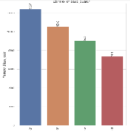
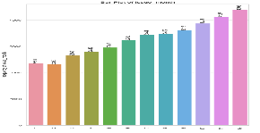
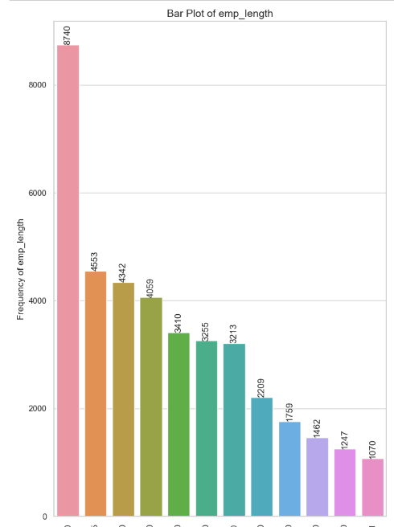
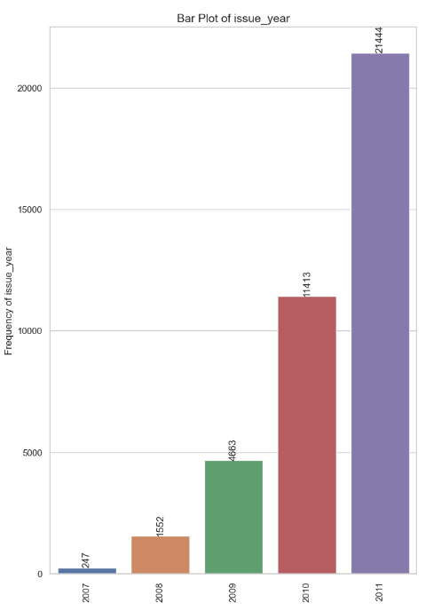
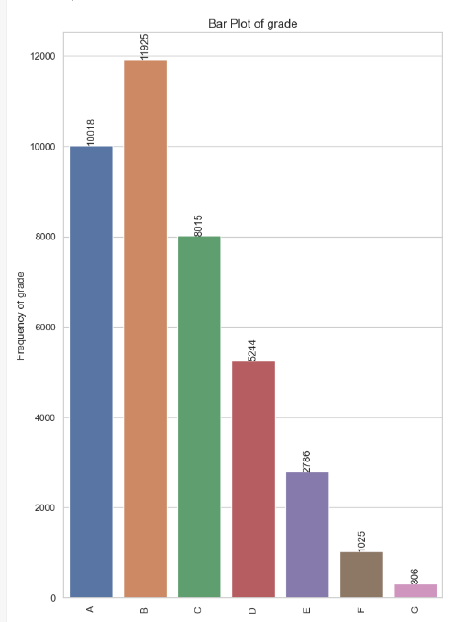
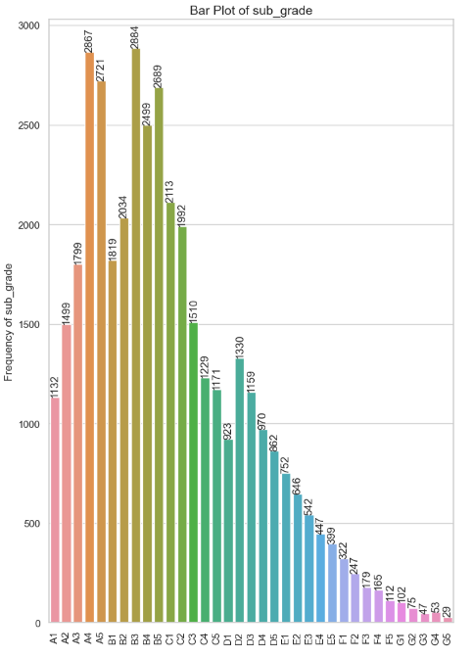
Ordered Category
Issued Quarter
Issue Month
Employment Experience
`Grade
Sub Grade
Issue Year

Slide 8
Ordered Category insight
Majority of loans are with grade 'A' and 'B' compared to rest
Majority of borrowers have working experience greater than 10 years. 11 kept for Unknown Category.
Majority of the loans are given in last quarter of the year.
Majority of the loans are given in the Year 2011.
Majority of the loans are given in December.

Slide 9
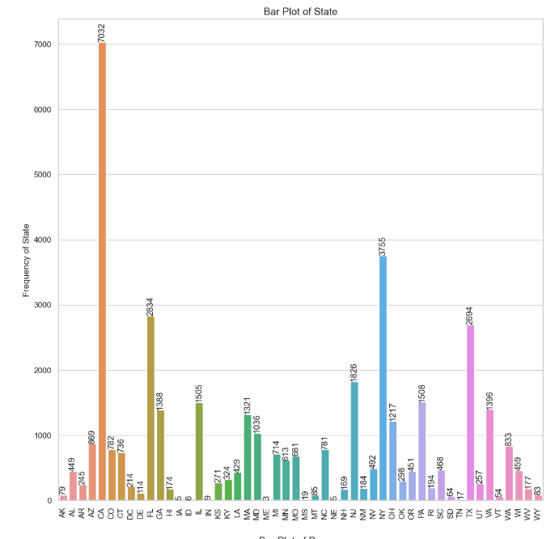
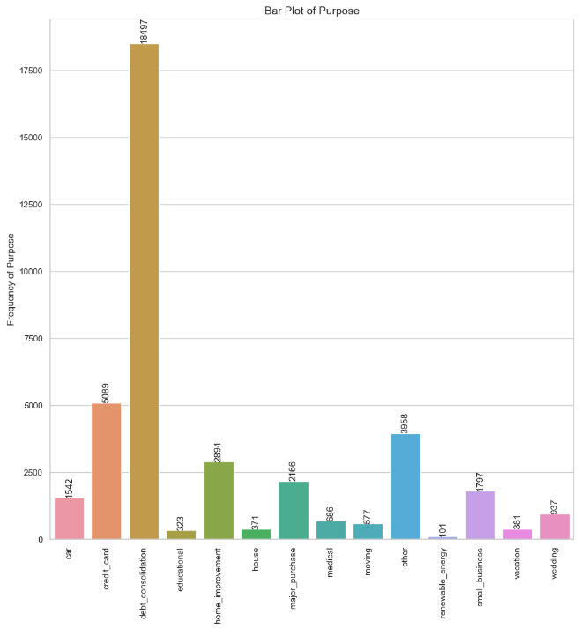
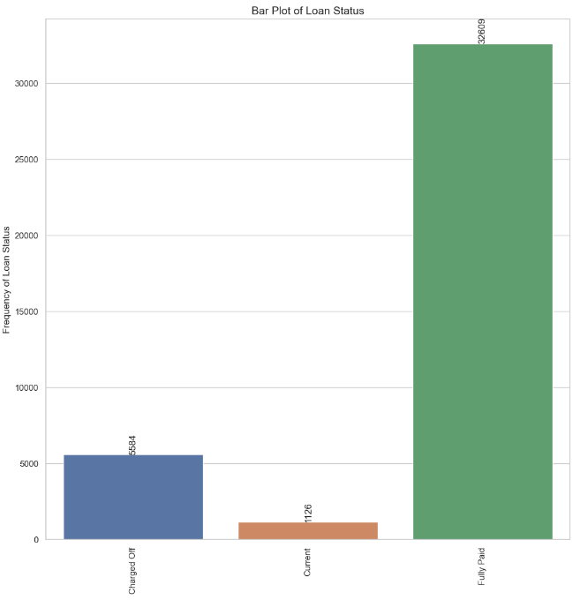
UnOrdered categorical

Slide 10
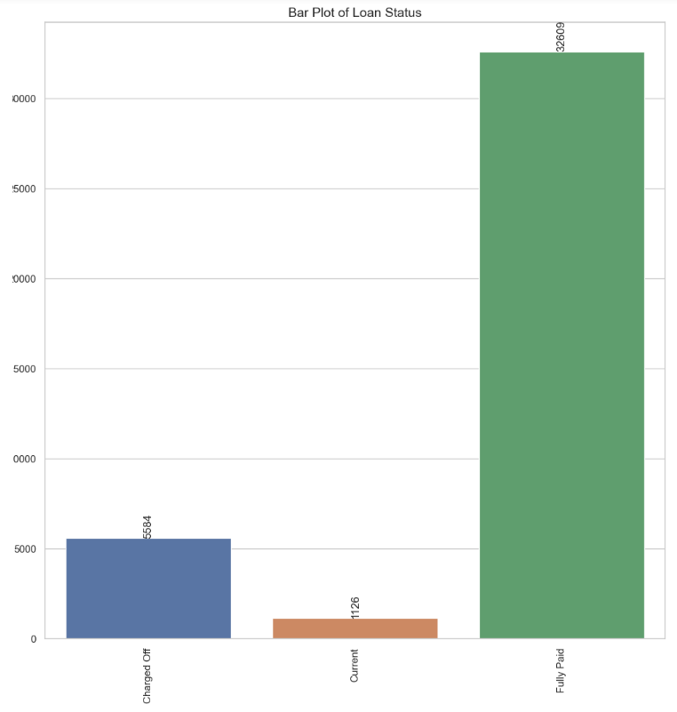
UnOrdered categorical

Slide 11
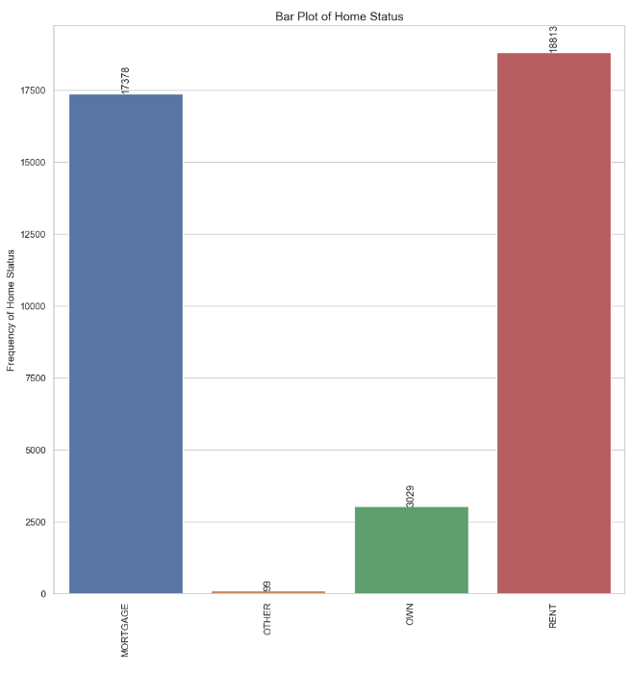
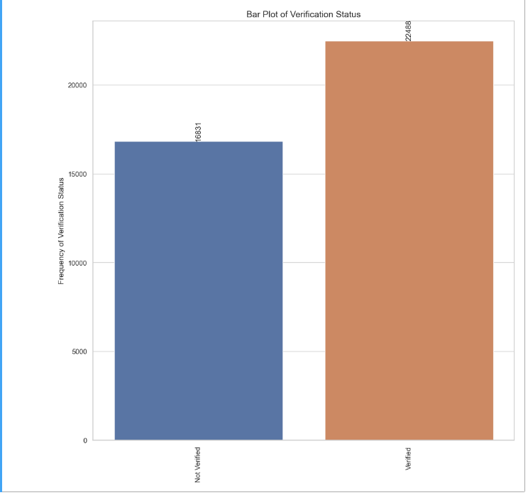
UnOrdered categorical

Slide 12
UnOrdered categorical insights
The number of defaulted loan is 6 times less than the number of fully paid loan.
A large percentage of loans are taken for debt consolidation followed by credit card.
Majority of the borrowers are from the urban States like california, new york, texas, florida etc.
Majority of borrowers don't possess property and are on mortgage or rent.
Majority of the borrowers have no record of Public Recorded Bankruptcy.
only 73% of the borrowers are verified by the company or have source verified.That is potential risk.

Slide 13
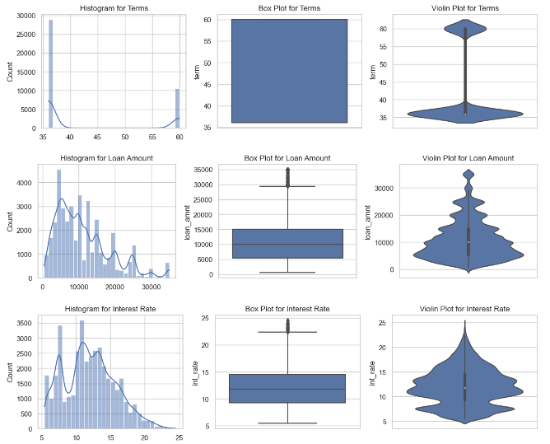
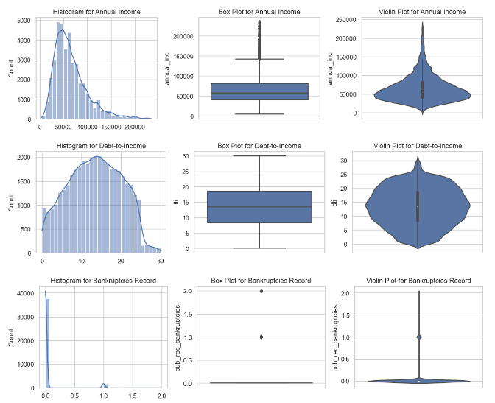
Quantitative variables

Slide 14
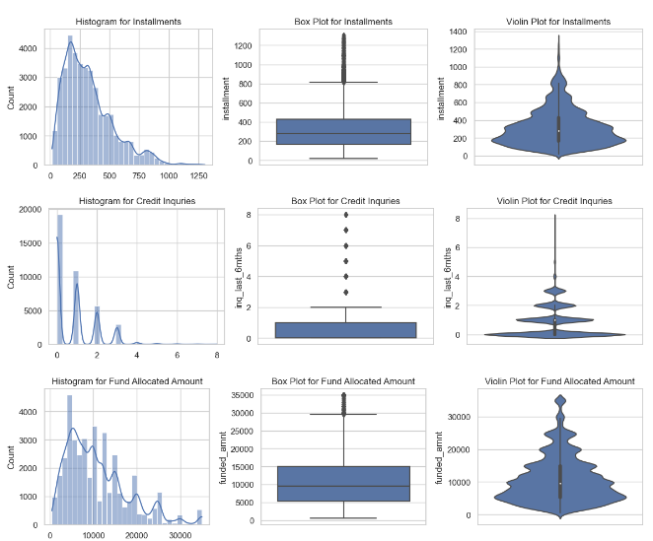
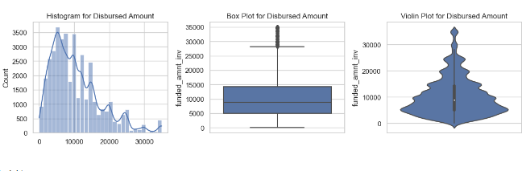
Quantitative variables

Slide 15
Quantitative variables Insights
The interest rate is more crowded around 5-10 and 10-15.
Majority of the borrowers have very large debt compared to the income registered, concentrated in the 10-15 DTI ratio.
Majority of the borrowers has annual income around 50 K
Loan Amount, Fund Amount and Disbursed amount follow the same pattern. so there is not much in the requested amount vs disbursed amount
Number of credit inquiries in past 12 months(inq_last_12m), are less for most of the approved loans
Most of the people have installment around 200
The majority of loan has a term of 36 months compared to 60 months.

Slide 16
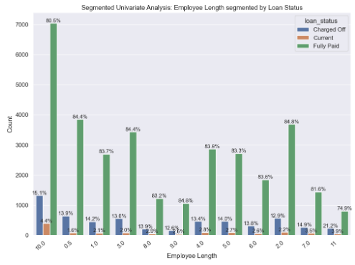
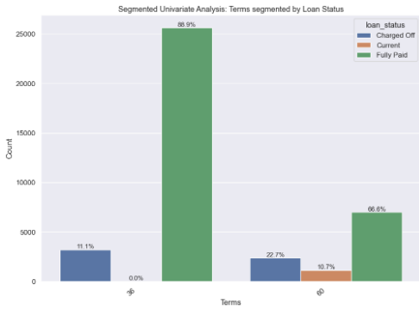
Segmented Univariate Analysis

Slide 17
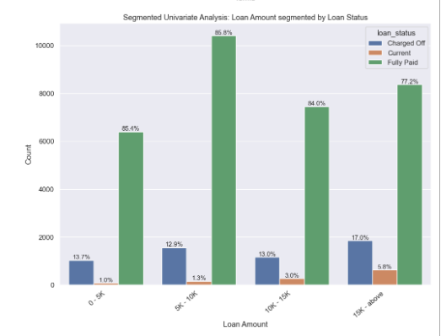
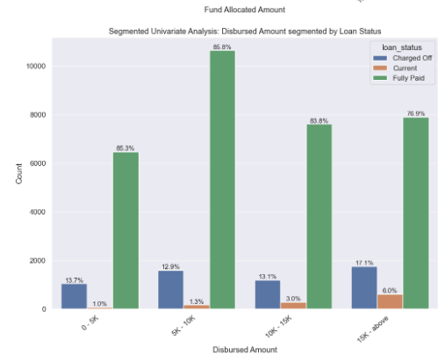
Segmented Univariate Analysis

Slide 18
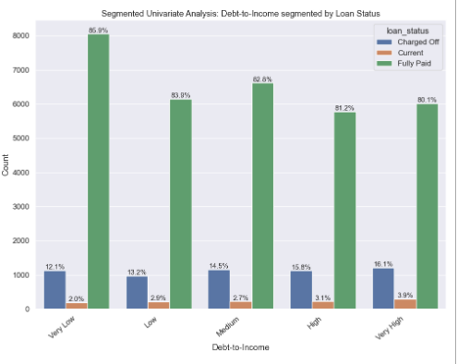
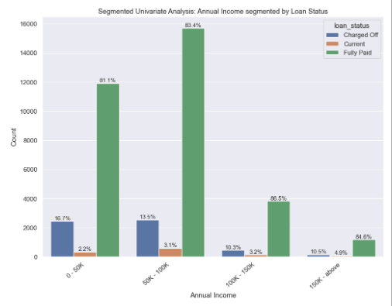
Segmented Univariate Analysis

Slide 19
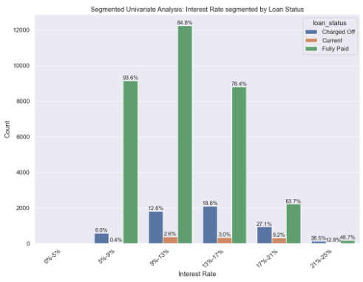
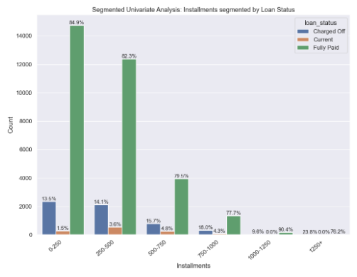
Segmented Univariate Analysis

Slide 20
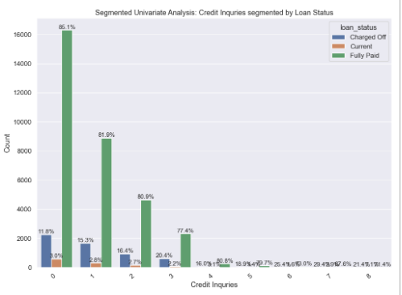
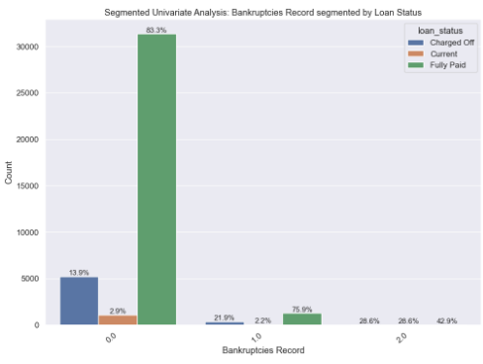
Segmented Univariate Analysis

Slide 21
Segmented Univariate Analysis Insights
Larger loans mean higher chance of defaulting.
60-month terms riskier, 36-month safer, with distinct grade distributions.
Higher DTI has more default risk, especially in High and Very High Bucket.
Default risk higher for those renting; lower for property owners.
Lower income (<15K) has higher default probability.
Defaulted number loan rise when interest rates increases.
Employees with 10+ years experience have higher chances to default .
Bankruptcies Record increases higher changes to default .
Installments increases higher changes to default .
More number of credit inquiries has higher changes to default .

Slide 22
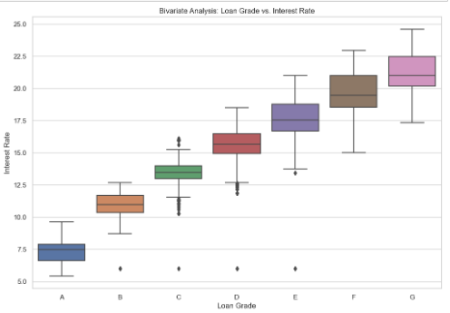
Bivariate Analysis
Loan Grade vs. Interest Rate
Grade increase the Interest Rate increases
This proves the interest calculation is based on the Grade

Slide 23
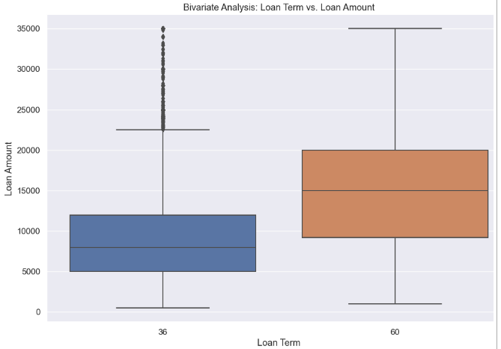
Bivariate Analysis
Loan Term vs. Loan Amount
More number of borrowers in the 36 Months term
Mode of loan amount in 60 month term is more than 36 which is normal. Because borrower get more amount as they need more time to settle.

Slide 24
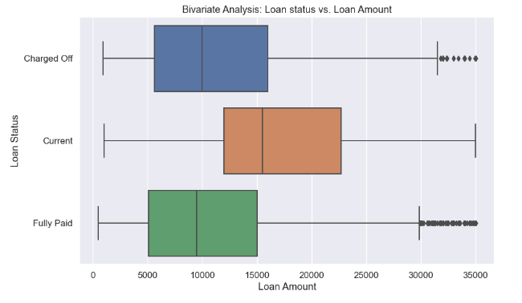
Bivariate Analysis
Loan Status vs. Loan Amount
Loan amount mostly lesser than 15K
Higher it grows, chances of default is more

Slide 25
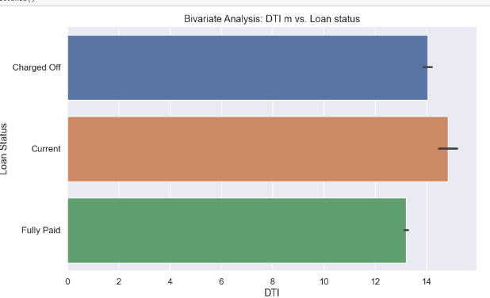
Bivariate Analysis
Loan Status vs DTI
Lower DTI is less riskier than higher DTI
Based on this analysis, Current loans are more riskier than usual.

Slide 26
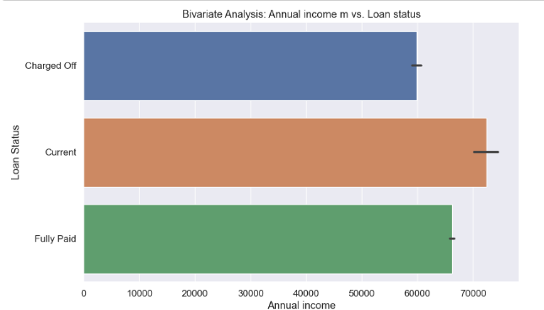
Bivariate Analysis
Loan Status vs. Annual income
High annual income is less the risk of default loan

Slide 27
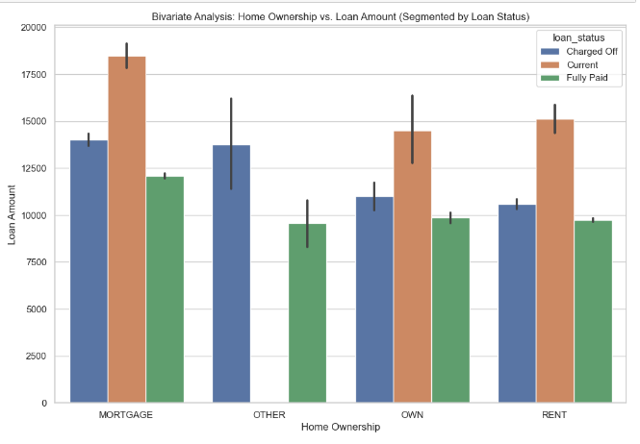
Bivariate Analysis
Home status vs Disbursed amount segmented by Status:
Borrowers living home in mortgage taking higher loan amount than others
For all home status, Loan amount increases, it becomes risky.

Slide 28
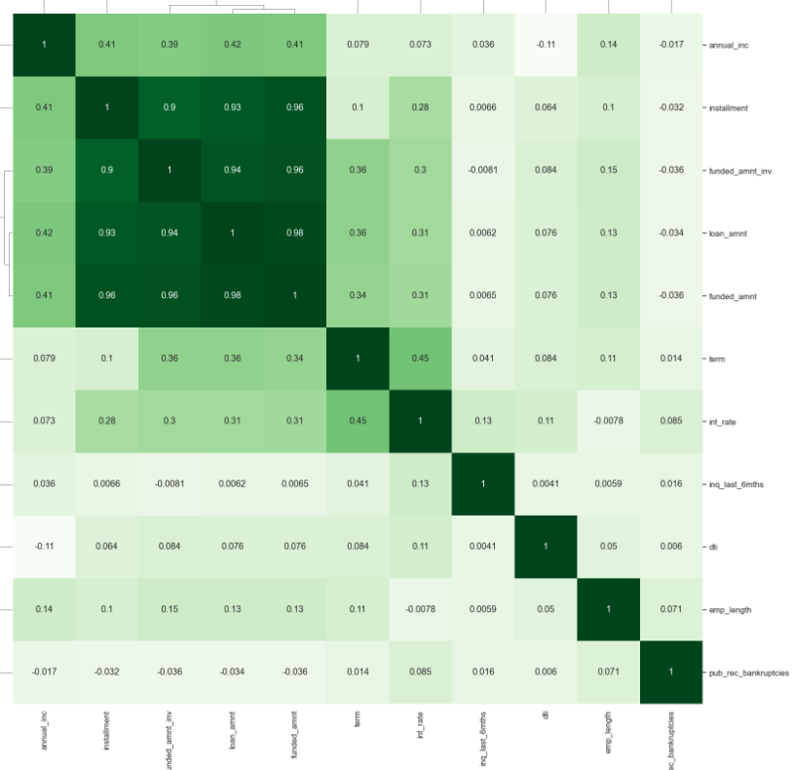
Correlation Analysis

Slide 29
Correlation Analysis
installment has a strong correlation with installment,funded_amnt, loan_amnt, and funded_amnt_inv
term has a strong correlation with interest rate
annual_inc has a strong correlation with loan_amount
dti has weak correlation with most of the fields
emp_length has weak correlation with most of the fields. Employee Experience is not significant factor on load lending process.
loan_amnt has strong correlation with installment,funded_amnt, and funded_amnt_inv
pub_rec_bankrupticies has a negative correlation with annual_inc, funded_amnt, loan_amnt, and funded_amnt_inv
annual_inc has a negative correlation with dti

Slide 30
Conclusion
Factors for predicting defaulting
DTI being higher
Lesser Annual income
Longer term(60 month)
Number of Public record of Bankruptcies is higher
Home status as Mortgage or rent
Higher Interest Rate
Higher Installment.
Other factor should be enforced
Enforce verification process for loan approval process. 20% loans are not verified
Borrower with higher grade(E and F) is risky as their interest rate is higher
Borrower with 10+ year experience , having higher risk than other.

